Slide 1
Advanced usages of flux
Emanuele Della Valle
Prof. @ Politecnico di Milano
Founder & Partner @ Quantia Consulting
Marco Balduini
Founder & CEO @ Quantia Consulting
Riccardo Tommasini
…

Slide 2
Time Series Enrichment

Slide 3
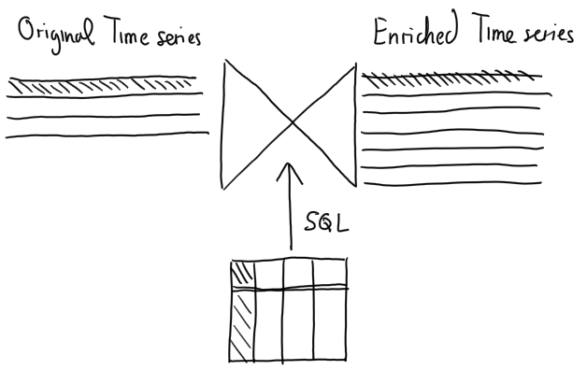
Time Series Enrichment – the intuition
IoT Sensors
Ratings
Metrics & Logs
I4.0 apps
Customer 360°
Traces
Enterprise Resource Planning
Customer Relationship Mng.
Micro-service topology
3

Slide 4
Use case for the Linear Pizza Oven
Enrich the IoT observations with the ID of the pizza and the kind of pizza contained in the Enterprise Resource Planning RDBMS

Slide 5
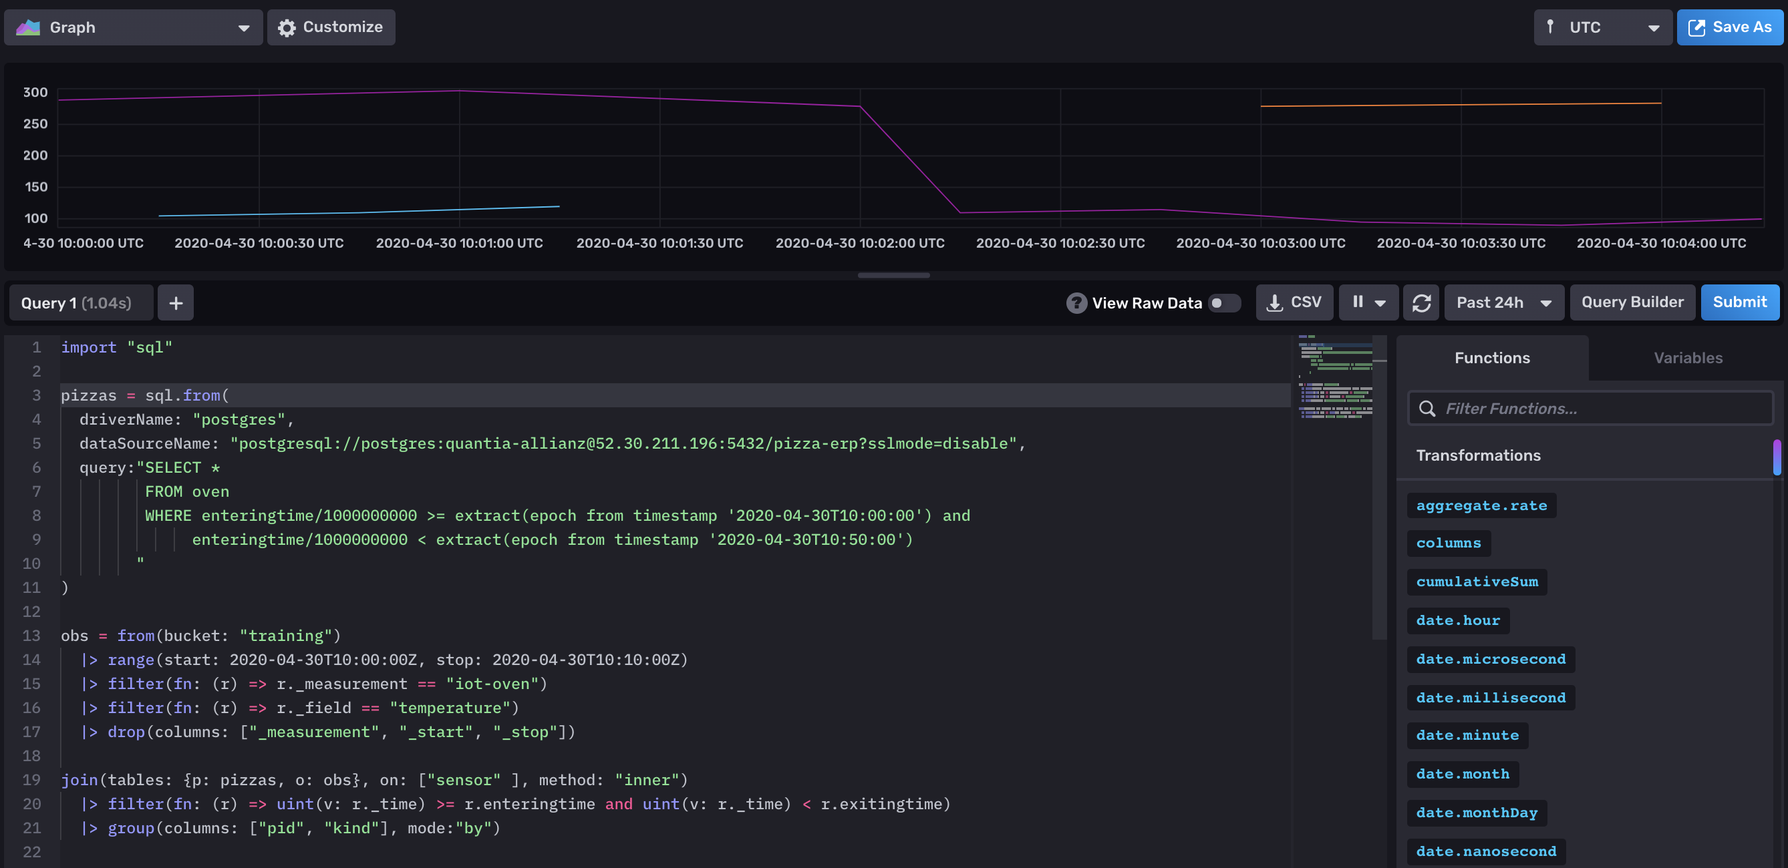
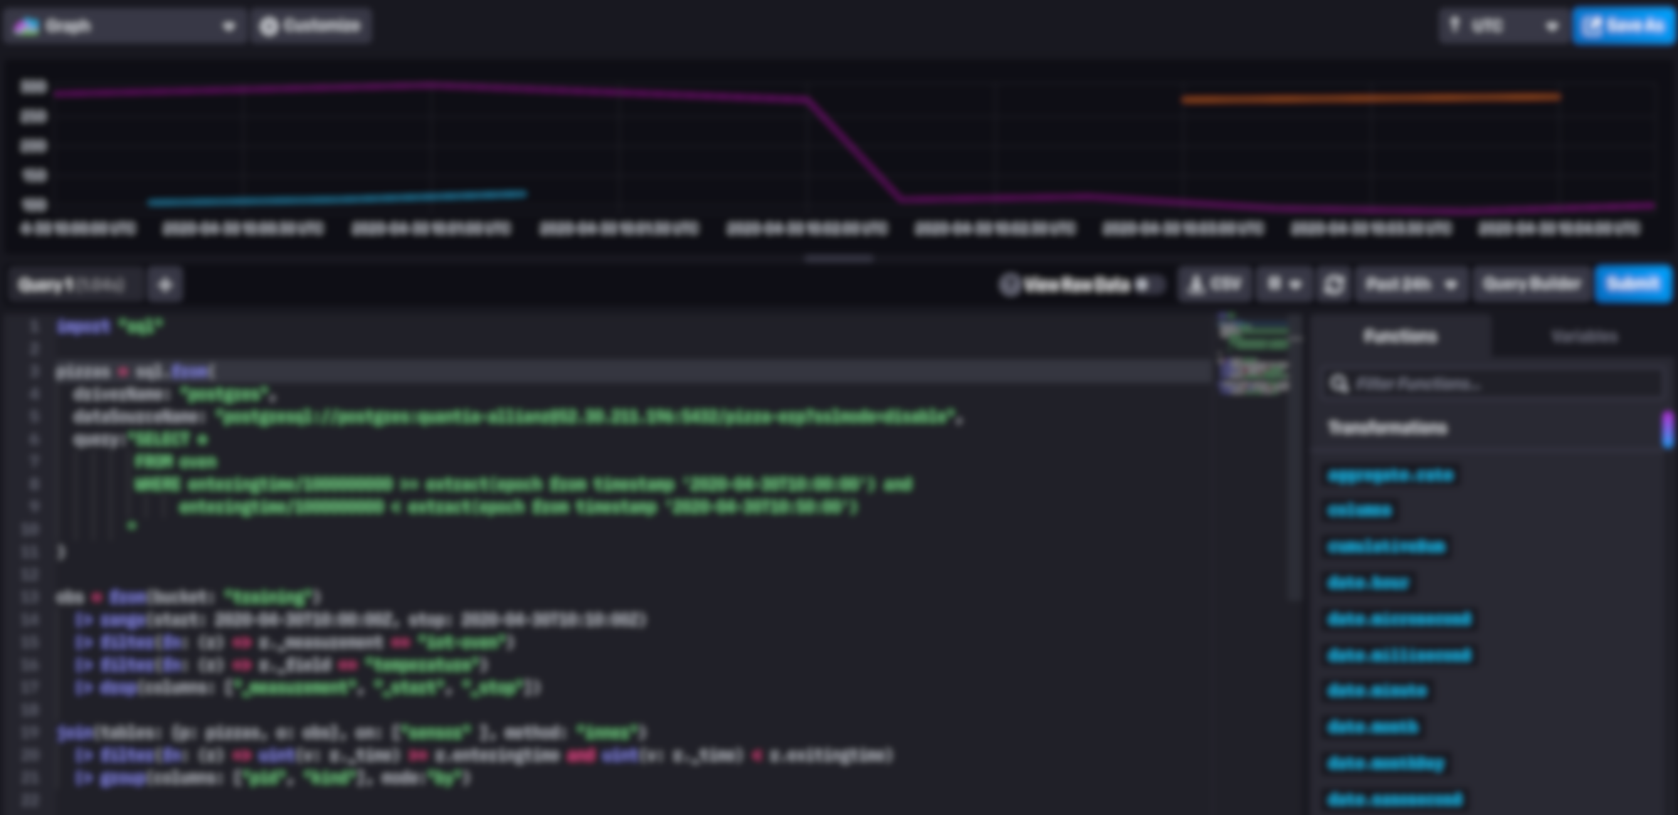
Time Series Enrichment in flux
5

Slide 6
Anomaly Detection

Slide 7
Anomaly Detection
Anomaly detection is a challenging data analysis task
Anomalies can represent
spurious data to clean out
important patterns to detect
This generality makes anomaly detection a powerful tool used in network security, remote sensing, fault detection, and many other domains
7

Slide 8
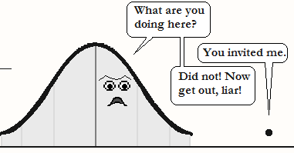
Anomaly Detection – the intuition
Considering the distribution of the data point in a time series, anomalous points are anomalies, a.k.a. outliers
[image: https://cerijayne.files.wordpress.com/2011/10/outliersss.png]
8

Slide 9
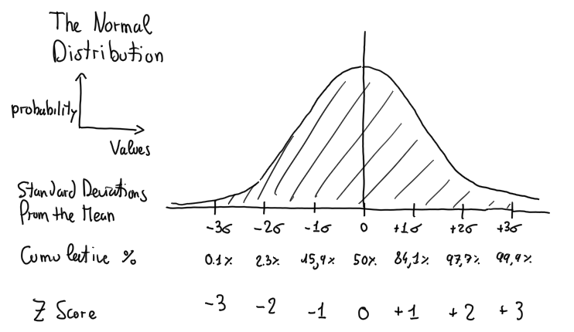
Let’s operationalize this intuition using the Z score
Z score
x – μ
σ
z
=
9

Slide 10
Let’s operationalize this intuition using the Z score
Z score
x – μ
σ
z
=
Anomaly
Abs(z) > 3
0.2% of data
10

Slide 11
Use case for the Linear Pizza Oven
Detect if a failures of the temperature controller of the mozzarella melting area
Correct behavior: 110 ± 10 C°
Anomalous: ?

Slide 12
Use case for the Linear Pizza Oven
Detect if a failures of the temperature controller of the mozzarella melting area
Correct behavior: 110 ± 10 C°
Anomalous: let’s compute the z-score where
the Mean is computed with aggregateWindow(every: 5m, fn: mean)
the StdDev is computed with aggregateWindow(every: 5m, fn: stddev)
the Z score is computed joining the times-series of all observations with the one of the Mean and the one the StdDev

Slide 13
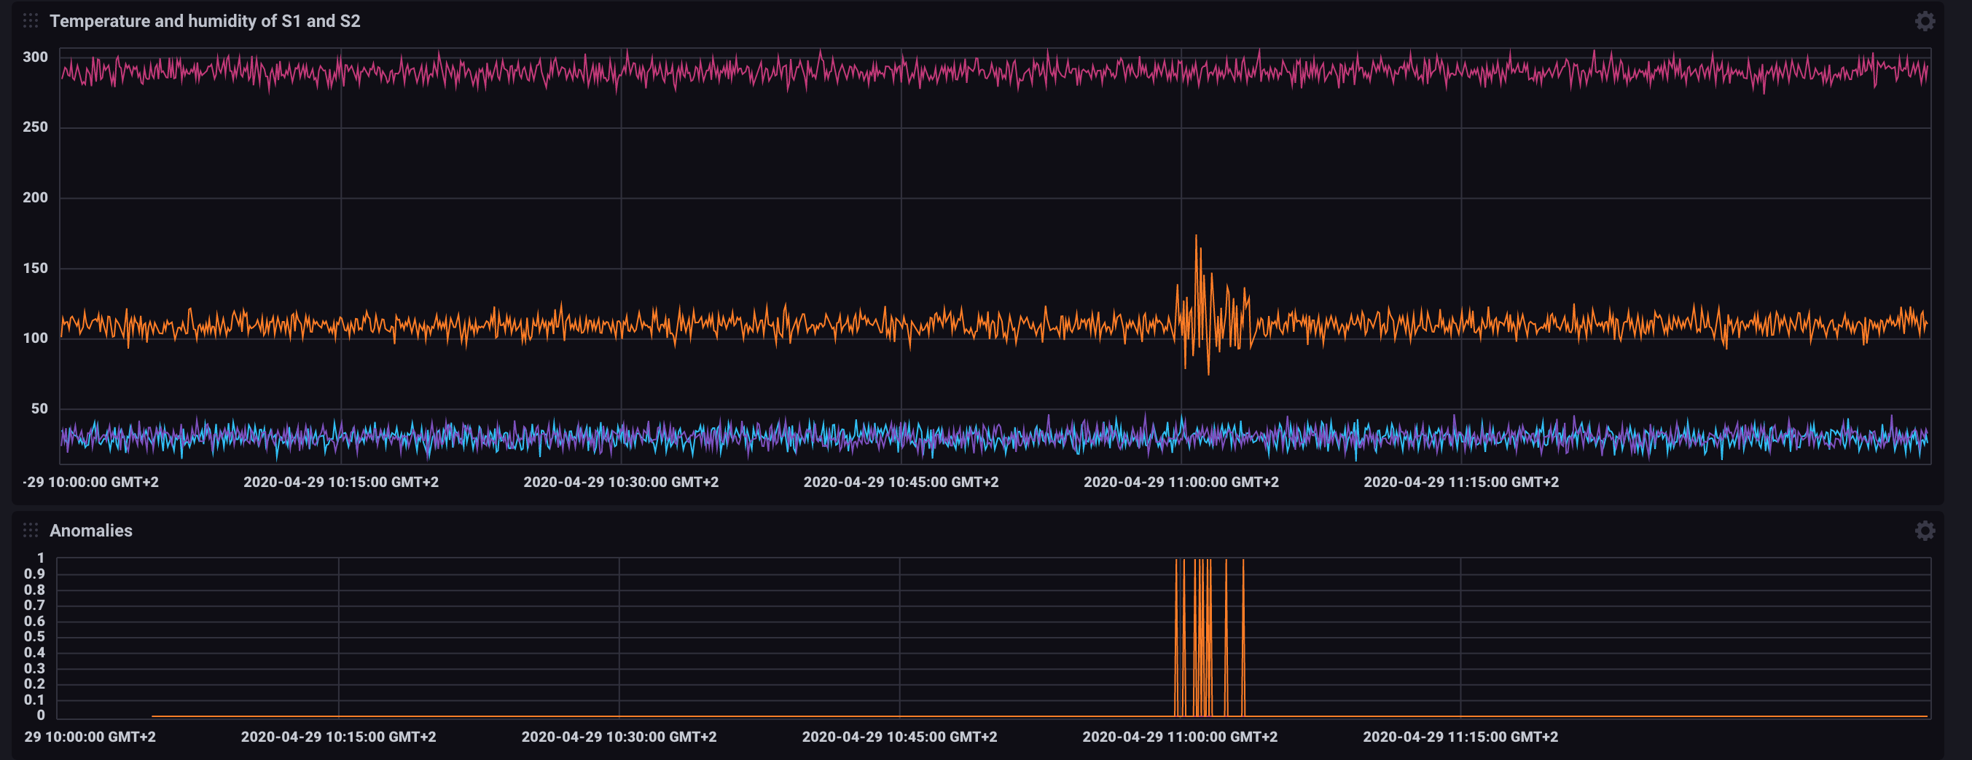
Use case for the Linear Pizza Oven – data viz

Slide 14
Use case for the Linear Pizza Oven – solution 1/3
movingAvg = from(bucket: "training")
|> range(start: v.timeRangeStart, stop: v.timeRangeStop)
|> aggregateWindow(every: 5m, fn: mean, createEmpty: false)
|> filter(fn: (r) => r._stop != r._time)
|> drop(columns: ["_start", "_stop", "_measurement"])
|> rename(columns: {_value: "avg"})

Slide 15
Use case for the Linear Pizza Oven – solution 2/3
movingStddev = from(bucket: "training")
|> range(start: v.timeRangeStart, stop: v.timeRangeStop)
|> aggregateWindow(every: 5m, fn: mean, createEmpty: false)
|> filter(fn: (r) => r._stop != r._time)
|> drop(columns: ["_start", "_stop", "_measurement"])
|> rename(columns: {_value: "stddev"})
join1 = join(tables: {all: movingAvg, avg: movingStddev}, on: ["_time","sensor","_field"])

Slide 16
Use case for the Linear Pizza Oven – solution 3/3
allData = from(bucket: "training")
|> range(start: v.timeRangeStart, stop: v.timeRangeStop)
|> drop(columns: ["_start", "_stop", "_measurement"])
join(tables: {all: allData, j: join1}, on: ["sensor","_field"])
|> filter(fn: (r) => uint(v: r._time_all)-uint(v: r._time_j) > 0)
|> filter(fn: (r) => uint(v: r._time_all)-uint(v: r._time_j) <= (5*60*1000000000))
|> map(fn: (r) => ({ r with zscore:
if math.abs(x: (r._value - r.avg)/r.stddev)>3 then 1 else 0}))

Slide 17

A Network Security example
Finding anomalies in the number of times users inserts a wrong password when they log into a system
Refuse the access to a user that inserts the right password at the first time if she gets in average the right password after 3 attempts
Much more effective than any rule based approach
17

Slide 18
Advanced Time Series Analytics

Slide 19
Holt-Winter’s method
Given a time series
It is often possible to extract
a trend: a long term variation of the time series.
a seasonality: a short term recurring pattern
What is left is call residual
19

Slide 20
Forecasting with Holt-Winter’s method
Data
Fitted
Forecast
Lower 2,5%
Upper 97,5%
20

Slide 21
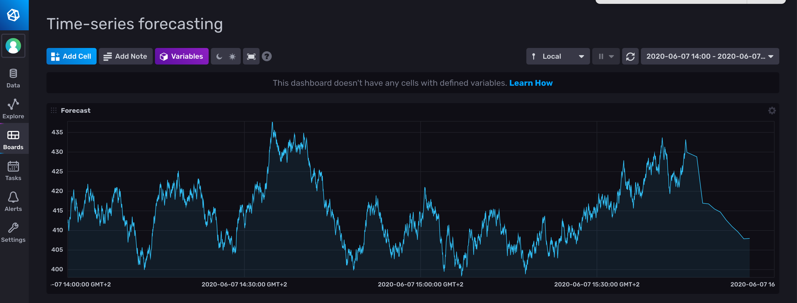
Holt-Winter’s in Flux
21

Slide 22
Holt-Winter’s in Flux
from(bucket: "training")
|> range(start: v.timeRangeStart, stop: v.timeRangeStop)
|> filter(fn: (r) => r._measurement == "fill_level")
|> filter(fn: (r) => r._field == "value")
|> filter(fn: (r) => r.tank == "B2")
|> aggregateWindow(every: 1m, fn: first)
|> holtWinters(n: 10, seasonality: 8, interval: 1m)

Slide 23
What (else) can I do with Flux?

Slide 24
What (else) can I do with flux?
Map/Reduce
Derivative, Difference, Integral
Histograms
Regular expression matching
String functions
Go Math library parity
Quantile
Conditional Expressions
Cross-measurement calculations
Conditional expressions
Sorting
Data Generation
In-language test assertions
…
And more every day!
24

Slide 25
Advanced usages of flux
Emanuele Della Valle Prof. @ Politecnico di Milano & Partner @ Quantia Consulting
Marco Balduini Founder & CEO @ Quantia Consulting
Riccardo Tommasini Prof. @ University of Tartu

